Slide 1

java mastery
Rana Sujeet Kumar

Slide 2

About us
At Contoso, we empower businesses to foster collaborative thinking to further drive workplace innovation. By closing the loop on task management and using the latest technology, we help businesses grow and nurture a consumer-first mindset.

Slide 3

day1
iNtroduction on to java
Basic Syntax
Data types and variables
Overview of java, Features and benefits ,
setting up the java development environment
Writing a Simple Java
Program, Explanation of
Main Method, Compiling and
Running a Java Program
Primitive Data Types,
Declaring and Initializing
Variables, Type Casting
Control Statements
If-Else Statements, SwitchCase Statements, Loops (for, while, do-while), Break and
Continue Statements

Slide 4
Introduction to Java
Overview of Java
Java is a high-level, class-based, object-oriented programming language that is designed to have as few implementation dependencies as possible. It is a general-purpose programming language intended to let application developers write once, run anywhere (WORA), meaning that compiled Java code can run on all platforms that support Java without the need for recompilation.

Slide 5




Features and Benefits of Java
Platform Independence:
Object-Oriented:
Robust:
Multithreaded:
Java code is compiled into bytecode, which can be run on any platform that has a Java Virtual Machine (JVM).
Promotes reusable code and modular projects.
Provides strong memory management, exception handling, and garbage collection.
Supports concurrent programming, allowing multiple threads to run simultaneously.

Slide 6

Benefits of Java
Secure: Features like bytecode verification, sandboxing, and cryptographic libraries enhance security. Rich API: Provides a vast set of libraries and frameworks for various applications. Community Support: A large community of developers and extensive documentation.

Slide 7

Setting up the Java Development Environment
Download and Install Java Development Kit (JDK):
Go to the Oracle JDK download page.
Choose the appropriate JDK for your operating system and follow the installation instructions.

Slide 8
Setting up the Java Development Environment
Set Up Environment Variables (Windows):
Right-click on 'My Computer' and select 'Properties'.
Go to 'Advanced system settings' and click on 'Environment Variables'.
Under 'System variables', click 'New' and add JAVA_HOME as the variable name and the path to your JDK installation as the variable value.
Find the 'Path' variable, click 'Edit', and add %JAVA_HOME%\bin.

Slide 9
Setting up the Java Development Environment
Install an Integrated Development Environment (IDE):
Popular IDEs for Java include Eclipse, IntelliJ IDEA, and NetBeans.
Download and install your preferred IDE from its official website.
Verify the Installation:
Open a command prompt or terminal.
Type java -version and javac -version to ensure Java is correctly installed.

Slide 10
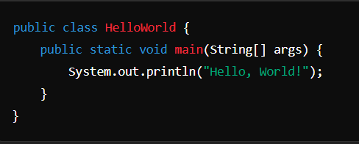
Basic Syntax
Writing a Simple Java Program
A simple Java program typically consists of a class definition and a main method. Here is an example of a basic Java program:

Slide 11

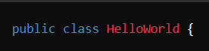
Let's break down this program step by step:
Class Definition:
public: This is an access modifier, which means this class is accessible by any other class.
class: This keyword is used to declare a class in Java.
HelloWorld: This is the name of the class. It should match the filename (HelloWorld.java).

Slide 12
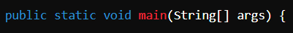
Let's break down this program step by step:
Main Method:
public: This means that the method is accessible from outside the class.
static: This means that the method belongs to the class, not instances of it. It can be called without creating an instance of the class.
void: This means that the method does not return any value.
main: This is the name of the method. It is the entry point of any Java program.
String[] args: This is a parameter, which is an array of String objects. It allows the program to accept command-line arguments.

Slide 13
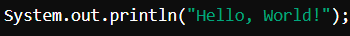
Let's break down this program step by step:
Print Statement:
Print Statement:
System.out: This is a standard output stream.
println(): This method prints the string inside the quotes and moves the cursor to a new line.
Compiling and Running a Java Program
Writing the Code:
Open your IDE or a text editor.
Write the code above and save the file as HelloWorld.java.

Slide 14
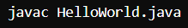
Run the compled class file using the java command
Compiling and Running a Java Program
Compiling the Program:
Open a command prompt or terminal.
Navigate to the directory where you saved HelloWorld.java.
Compile the code using the javac command
Running the Program:
Run the compiled class file using the java command
You should see the output:

Slide 15
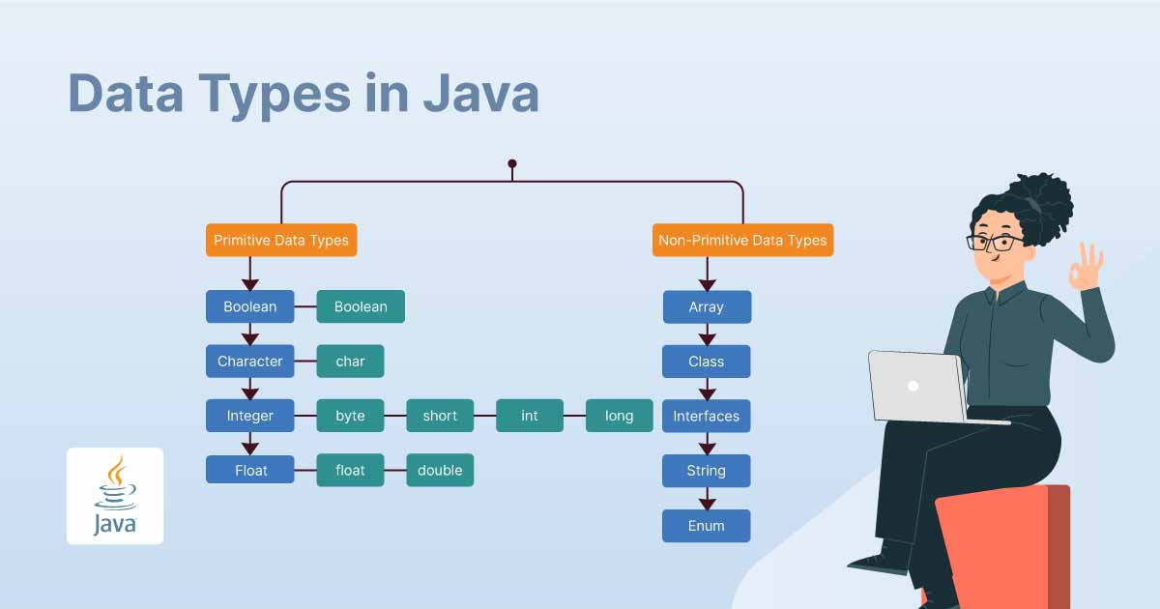

Data Types and Variables

Slide 16
Data Types and Variables
Primitive Data Type: such as boolean, char, int, short, byte, long, float, and double
byte: 8-bit signed integer.
byte b = 10;
short: 16-bit signed integer.
short s = 200;
int: 32-bit signed integer.
int age = 25;
long distance = 15000000000L;
long: 64-bit signed integer.
float: Single-precision 32-bit floating point.
float pi = 3.14f;
int age = 25; // Declaration and initialization
double salary = 50000.75;
char grade = 'A';
boolean isJavaFun = true;
int age;
age = 25; int num = 10;
double d = num; // Implicit casting

Slide 17
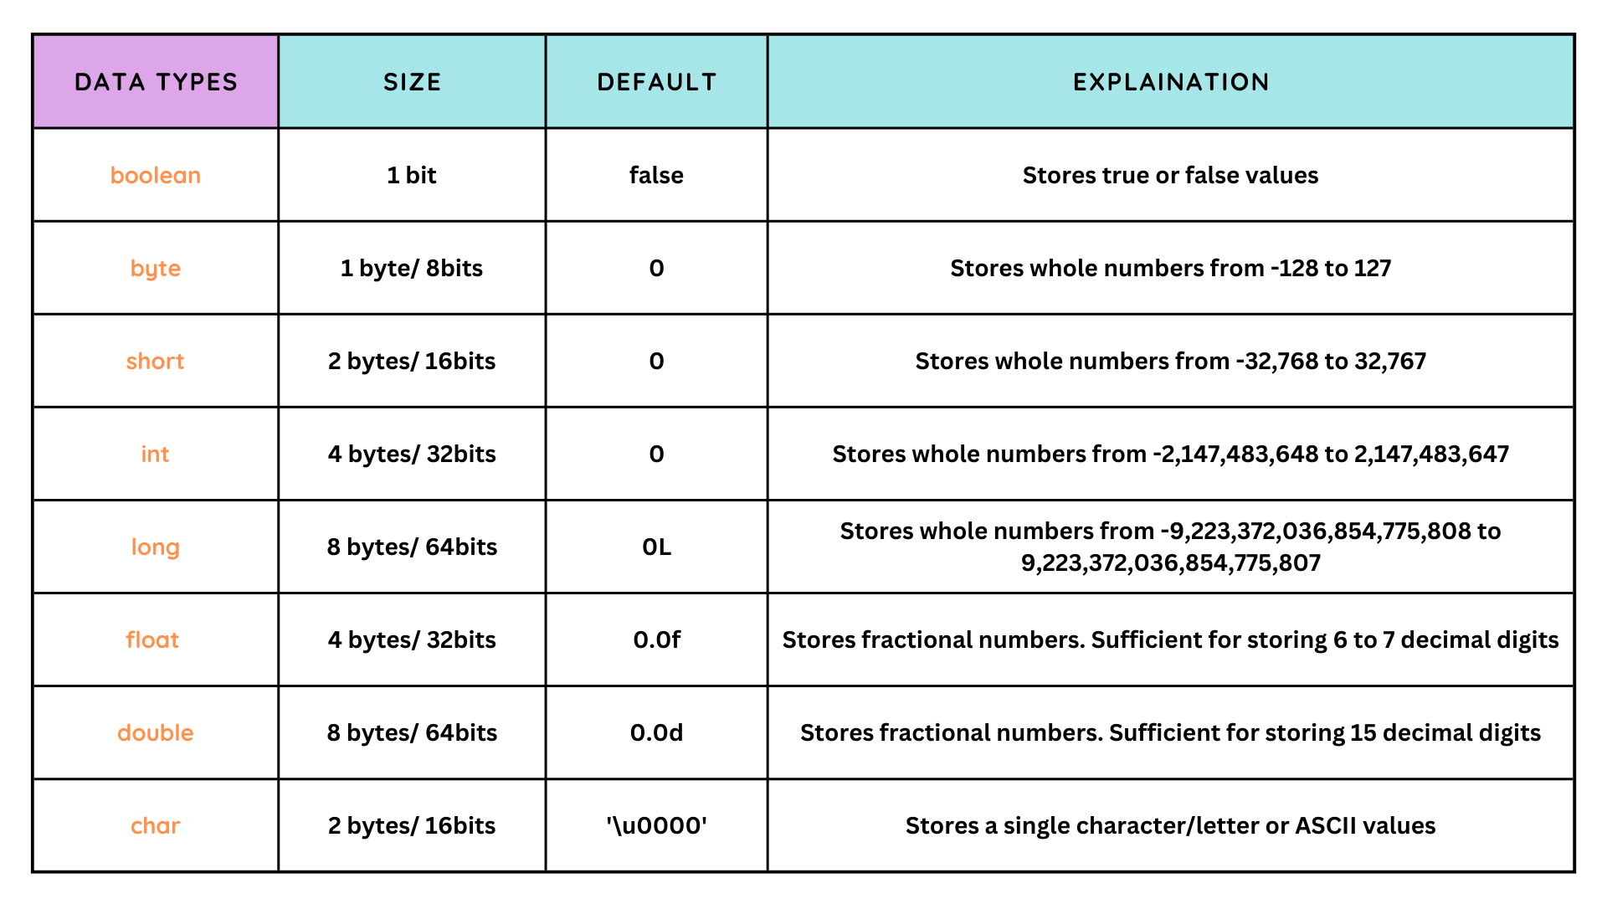
⌚ Primitive Data Types
Convenient
Contoso
A
Expensive​
Affordable
B
D
E
C
Inconvenient​

Slide 18
Non-Primitive Data Types
String: A String in Java is a sequence of characters. It is not a primitive data type but a class that belongs to the java.lang package. Strings are used to store and manipulate text.
public class StringExample {
public static void main(String[] args) {
String greeting = "Hello, World!";
System.out.println(greeting);
}
}
Array:An array is a collection of elements of the same data type. Arrays in Java are objects that store multiple variables of the same type. The size of the array is fixed after it is declared.
int[] numbers = {1, 2, 3, 4, 5}; // Declaration and initialization String[] fruits = new String[3]; // Declaration with size
fruits[0] = "Apple"; fruits[1] = "Banana"; fruits[2] = "Cherry";

Slide 19
Type Casting
Type casting is the process of converting one data type into another. There are two types of type casting in Java:
Implicit Casting (Widening Conversion): Automatically performed when converting a smaller type to a larger type size.
int num = 10;
double d = num; // Implicit casting
Explicit Casting (Narrowing Conversion): Must be performed manually by placing the type in parentheses in front of the value.
double salary = 50000.75;
int roundedSalary = (int) salary; // Explicit casting

Slide 20
Type Casting
Example Program
Here's an example program demonstrating the use of primitive data types, variable declaration, initialization, and type casting:
public class DataTypesDemo {
public static void main(String[] args) {
// Declaration and initialization
int age = 25;
double salary = 50000.75;
char grade = 'A';
boolean isJavaFun = true;
// Implicit casting
double newSalary = age; // int to double
// Explicit casting
int roundedSalary = (int) salary; // double to int
// Output the values
System.out.println("Age: " + age);
System.out.println("Salary: " + salary);
System.out.println("Grade: " + grade);
System.out.println("Is Java Fun: " + isJavaFun);
System.out.println("New Salary (implicit cast): " + newSalary);
System.out.println("Rounded Salary (explicit cast): " + roundedSalary);
}
}

Slide 21
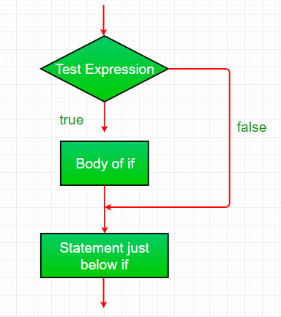
Control Statements
Control statements in Java allow you to control the flow of execution of your program based on certain conditions or iterations. They include if-else statements, switch-case statements, and loops (for, while, do-while), as well as break and continue statements.
If-Else Statements
The if-else statement allows you to execute different blocks of code based on a condition.
int number = 10;
if (number > 0) {
System.out.println("Positive number");
} else {
System.out.println("Non-positive number");
}

Slide 22
Switch-Case Statements: The switch-case statement is used to execute one block of code from multiple options.
case 5:
System.out.println("Friday");
break;
case 6:
System.out.println("Saturday");
break;
case 7:
System.out.println("Sunday");
break;
default:
System.out.println("Invalid day");
break;
}
int day = 3;
switch (day) {
case 1:
System.out.println("Monday");
break;
case 2:
System.out.println("Tuesday");
break;
case 3:
System.out.println("Wednesday");
break;
case 4:
System.out.println("Thursday");
break;

Slide 23
Loops
Loops are used to execute a block of code repeatedly.
For Loop:
A for loop is used when you know the number of iterations in advance.
public class ForLoopExample {
public static void main(String[] args) {
// For loop to print numbers from 1 to 5
for (int i = 1; i <= 5; i++) {
System.out.println("For loop iteration: " + i);
}
}
}

Slide 24
While Loop:
A while loop is used when you don't know the number of iterations in advance and the loop continues until the condition becomes false.
public class WhileLoopExample {
public static void main(String[] args) {
int i = 1;
// While loop to print numbers from 1 to 5
while (i <= 5) {
System.out.println("While loop iteration: " + i);
i++;
}
}
}

Slide 25
Do-While Loop:
A do-while loop is similar to a while loop, but it ensures that the loop body is executed at least once before checking the condition
public class DoWhileLoopExample {
public static void main(String[] args) {
int i = 1;
// Do-while loop to print numbers from 1 to 5
do {
System.out.println("Do-while loop iteration: " + i);
i++;
} while (i <= 5);
}
}

Slide 26

Thank you

